Slide 1
An Introduction to DATA SCIENCE

Slide 2
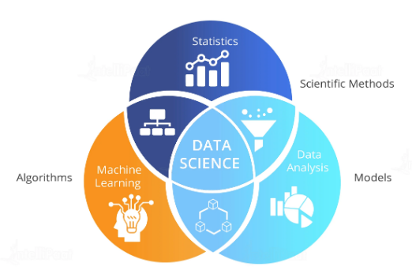
What is Data Science?
Data science is an interdisciplinary field that uses algorithms, procedures, and processes to examine large amounts of data in order to uncover hidden patterns, generate insights, and direct decision making.

Slide 3
01
Importance of Data Science

Slide 4

Career Opportunities
"The rise of Data Science needs will create roughly 11.5 million job openings by 2026" US Bureau of Labour Statistics "By 2026, Data Scientists and Analysts will become the number one emerging role in the world." World Economic Forum Data Science and Artificial Intelligence are amongst the hottest fields of the 21st century that will impact all segments of daily life from transport and logistics to healthcare and customer service.

Slide 5
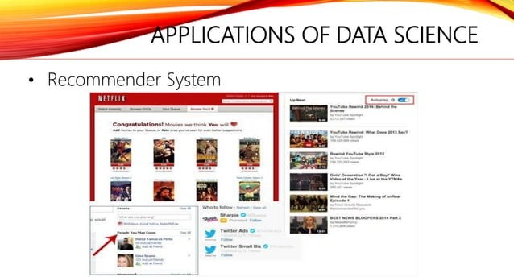

Slide 6
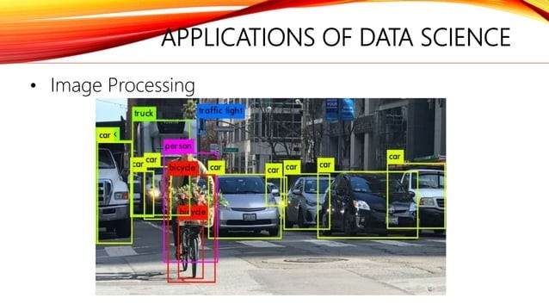

Slide 7
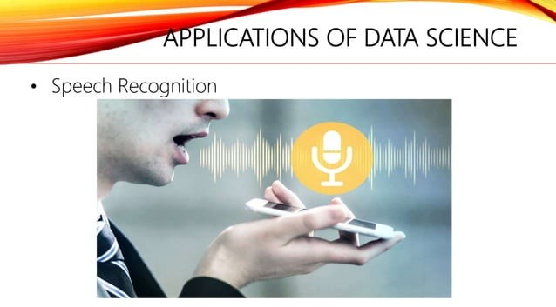

Slide 8
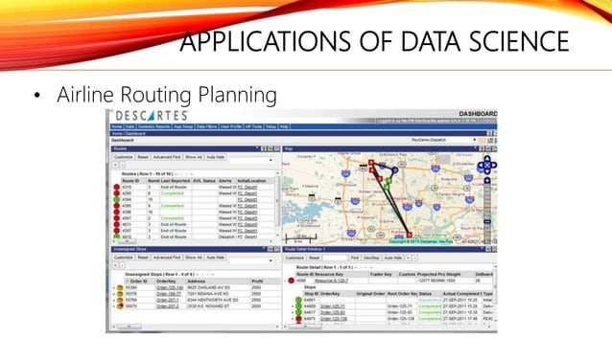

Slide 9
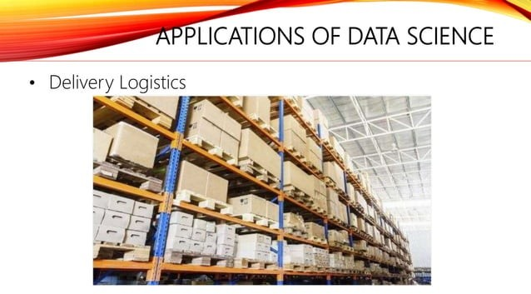

Slide 10
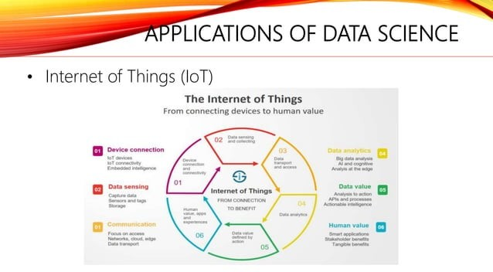

Slide 11
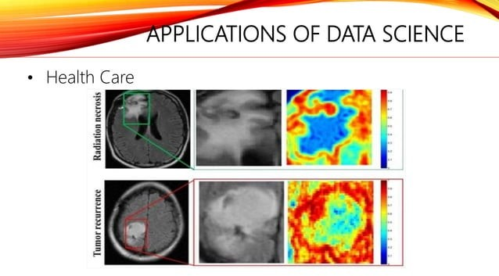

Slide 12
02
How does Data Science Work?

Slide 13
How does Data Science Work?
Collect Data
Analyze Data
Insights
Raw data is gathered from various sources that explain the business problem
Using various statistical analysis, and machine learning approaches, data modeling is performed to get the optimum solutions that best explain the business problem.
Actionable insights that will serve as a solution for the business problems gathered through data science.

Slide 14
03
AI and Data Science

Slide 15
Data science and artificial intelligence are not the same.
“Data science and artificial intelligence are two technologies that are transforming the world. While artificial intelligence powers data science operations, data science is not completely dependent on AI. Data Science is leading the fourth industrial revolution. ”

Slide 16
Data science also requires machine learning algorithms, which results in dependency on AI.

Slide 17
Comparison Between AI and Data Science
Data science jobs require the knowledge of ML languages like R and Python to perform various data operations and computer science expertise.
Data science uses more tools apart from AI. This is because data science involves multiples steps to analyze data and generate insights.
Data science models are built for statistical insights whereas AI is used to build models that mimic cognition and human understanding.

Slide 18
Comparison Between AI and Data Science
Today’s industries require both, data science and artificial intelligence. Data science will help them make necessary data-driven decisions and assess their performance in the market, while artificial intelligence will help industries work with smarter devices and software that will minimize workload and optimize all the processes for improves innovation.

Slide 19
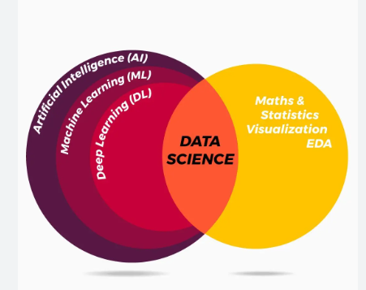
Comparison Between AI and Data Science

Slide 20
04
Prerequisites for Data Science

Slide 21
Data Science is a science which uses :
Computer Science
Machine Learning
Statistics
Visualization

Slide 22
Roadmap of Data Science
3. Data Visualization
1. Learn Programming Language
Involves charts,graphs etc. We have already two libraries in Python for this i.e Seaborn, matplotlib
Commonly used languages are python and R
4. Machine Learning
2. Mathematics & Statistics
Know about basic algorithms of ML like Linear regression, Logistic regression, Decision tree, SVM algorithm, KNN algorithm , Random forest algorithm.
Like mean, median , mode, standard deviation etc.
5. Project
Try to make projects with the help of Kaggle

Slide 23
Python :
Python is also most popular programming language among data scientists these days.
Python is very versatile and can be used in almost all the processes in Data Science.
Be it data mining or running embedded systems, python can do everything, and because of this, 40% of the people that participated in a survey by O’Reilly said that they used Python most often.
Pandas, a python library, is used for data analysis and can do anything from plotting data with histograms, to importing data from spreadsheets.
Python can take data in various formats and import SQL tables to your code easily.
The python packages you need to master are Numpy, Matplotlib, Pandas, Scikit-Learn, and Seaborn in Python.

Slide 24
Mathematics and Statistics
Mathematics is one of the very popular Prerequisites for Data Science. Probability and Statistics are used for data imputation, visualization of features, feature transformation, model evaluation, dimensionality reduction, feature engineering and data preprocessing.
Multivariable Calculus is used to build Machine Learning Models. For Model Evaluation, Data Preprocessing and Data Transformation, we use linear Algebra. A matrix is used to represent a Data set.

Slide 25
Machine Learning and Artificial Intelligence –
ML helps in analyzing large amounts of data using algorithms. Using Machine Learning, major parts of a data scientist’s jobs can be automated.
Only a small percentage of Data Scientists are proficient with advanced machine learning techniques like adversarial learning, neural networks, reinforcement learning, Outlier Detection, Time Series etc.
The most skilled data scientists are highly familiar with advanced machine learning techniques such as recommendation engines and Natural Language Processing.
If you want to stand out from the crowd and be one at the top tier, knowledge of machine learning techniques such as logistic regression, supervised machine learning, decision trees, Survival Analysis, Computer Vision, etc., is a must.

Slide 26
Start making small Data Science projects with the help of Kaggle Inside Kaggle you’ll find all the code & data you need to do your data science work. Use over 50,000 public datasets and 400,000 public notebooks to conquer any analysis in no time.

